Slide 1

Medical expense
Prediction
Using
Machine Learning
Shanthi Rama

Slide 2





Objective:
To predict future Medical expense of an individual given his physical/family condition & location (Regression)
Use-Case:
Helps Health Insurance Companies to customize insurance plans & premium for their customers.
Tools:

Slide 3
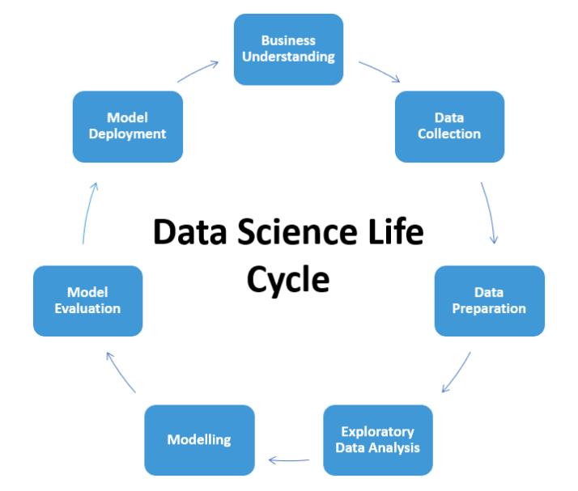

Workflow:

Slide 4



Connections:

Slide 5
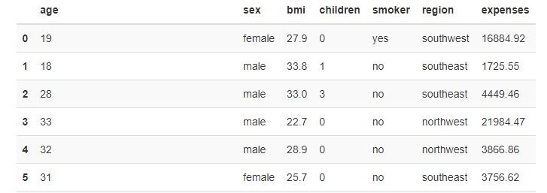
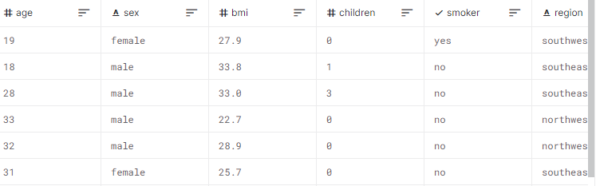

Data Collection:
1338 rows
7 columns
age: age of primary beneficiary
sex: gender, female/ male
bmi: Body mass index,ideal 18.5 to 24.9
children: Number of dependents
smoker: Smoking yes/no
region: residential area, northeast, southeast, southwest, northwest.
charges: Individual medical costs billed by health insurance
Data Source: Kaggle

Slide 6

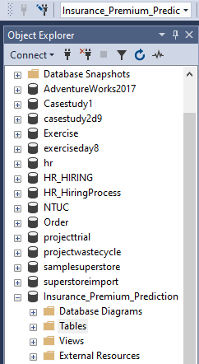
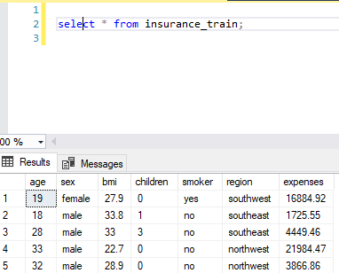
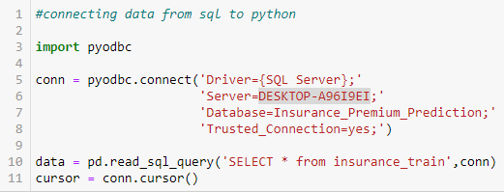
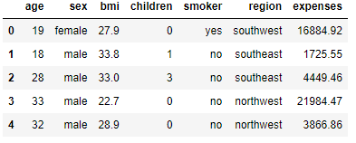
SQL to Python Connection:
data.head()

Slide 7

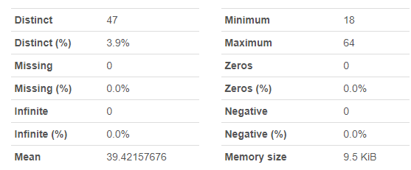
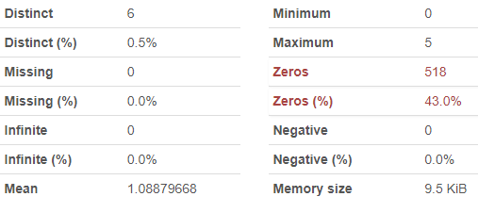
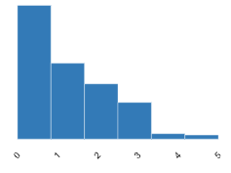
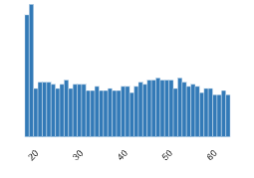
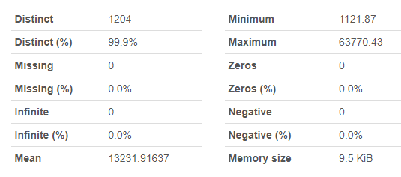
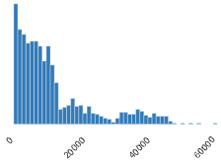
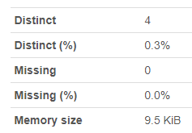
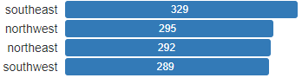
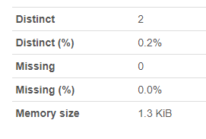
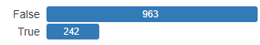
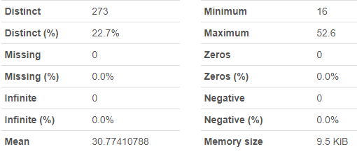
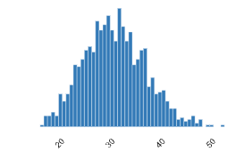
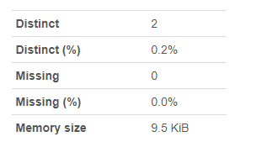
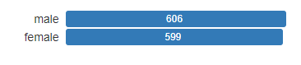
EDA:
Children
Age
Expense
Region
Smoker
Bmi
Sex

Slide 8
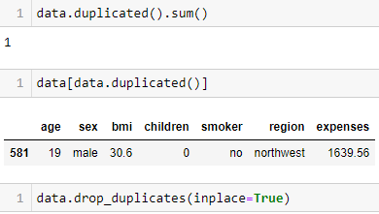
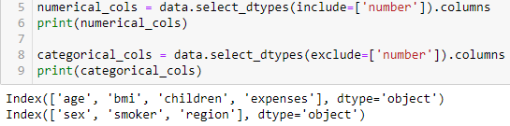
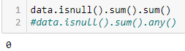
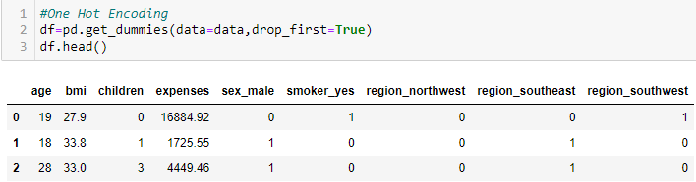
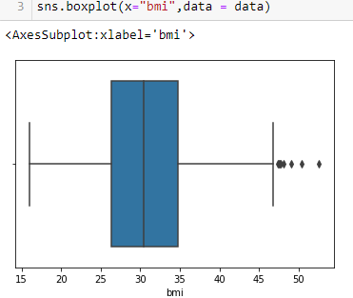
Data Preprocessing:
1)Duplicates
2)Null values
3)Outliers
4) Categorical/Numerical data
5)Get dummies for Categorical columns

Slide 9

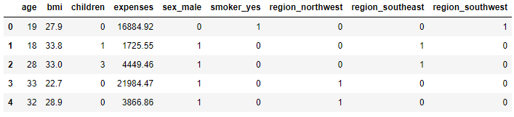
Pre-processed Data:
Before
After

Slide 10

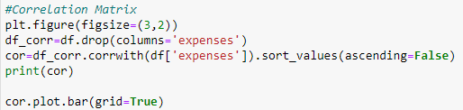
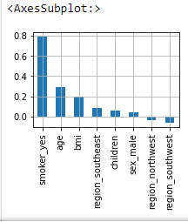
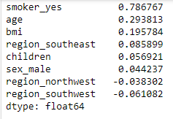
Correlation:
Correlation plot

Slide 11
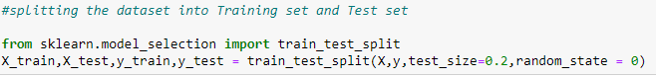
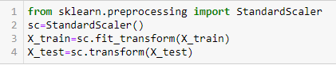
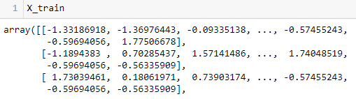
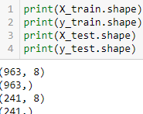
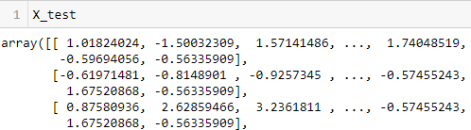

Splitting the data:
Preparing for Data Modelling:
Feature Scaling:

Slide 12
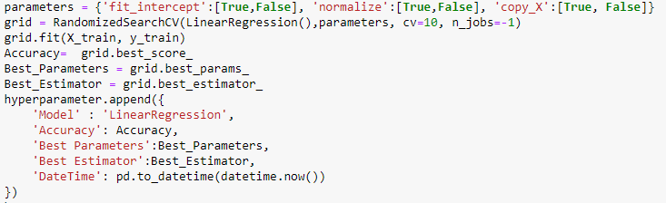
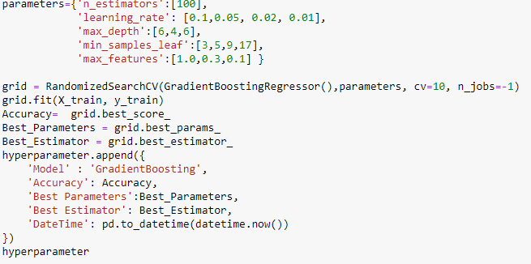
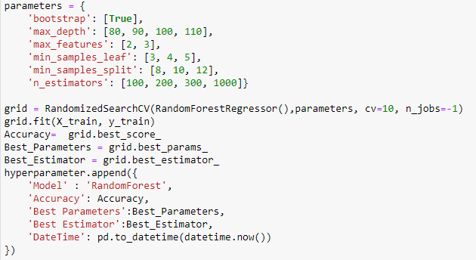
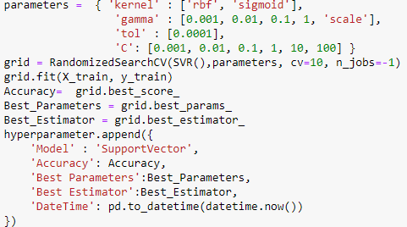
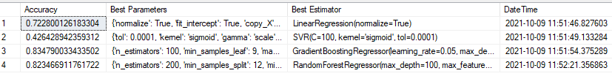
Hyperparameter Tuning:
RandomSearchCV
1)Linear Regression
2)GradientBoostingRegressor
3)RandomForest
4)SupportVector
'Best Estimator': GradientBoostingRegressor(learning_rate=0.05, max_depth=4, max_features=1.0, min_samples_leaf=17),

Slide 13
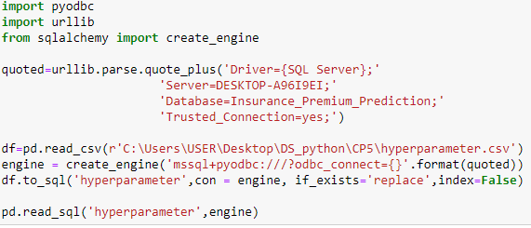
Python to SQL connection:
Load ‘hyperparameter’ Table into Sql
Export into Sql

Slide 14
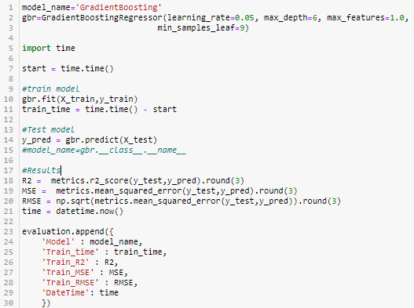
Data Modelling using Best Estimator
'Best Estimator': GradientBoostingRegressor(learning_rate=0.05, max_depth=4, max_features=1.0, min_samples_leaf=17),
Regressor Models:
1)Linear Regression
2)GradientBoosting
3)RandomForest
4)SupportVector

Slide 15
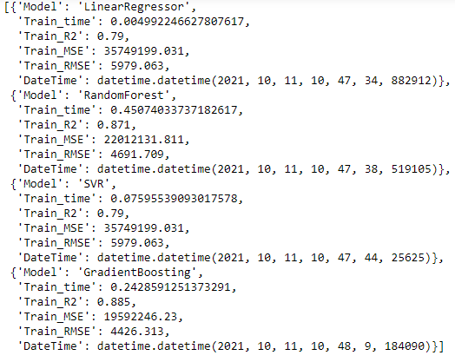
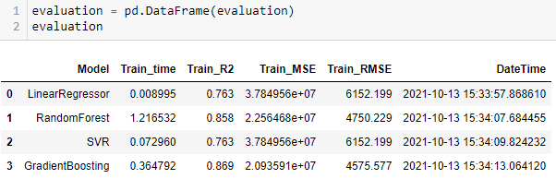
Model Evaluation:
GradientBoosting gives better R^2 0.869 compared to other models

Slide 16

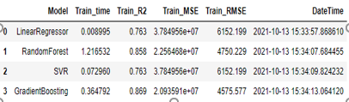
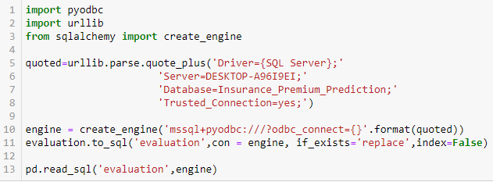

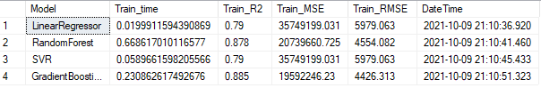
Loading Evaluation Table into SQL:
Python DataFrame:
Export into Sql
Sql:

Slide 17
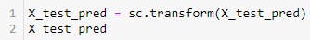
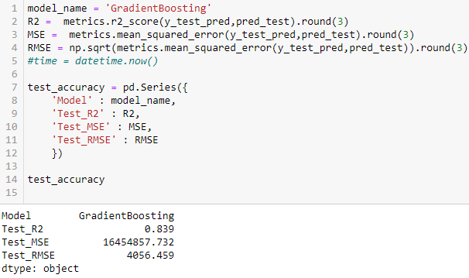
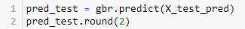



Predict the Test data: GradientBoosting
Metric Score:

Slide 18


Load ‘Accuracy’ Table into Sql:
Import above table into SQL:

Slide 19

Glance of all imported Tables in SQL:

Slide 20

Data Visualisation

Slide 21



Sql to Power BI Connection

Slide 22


Slide 23


Slide 24


Slide 25

Conclusion: If we have more details of the individual like current medical condition, test reports, etc we can achieve better Accuracy

Slide 26

Thank You!!!

